Slide 1
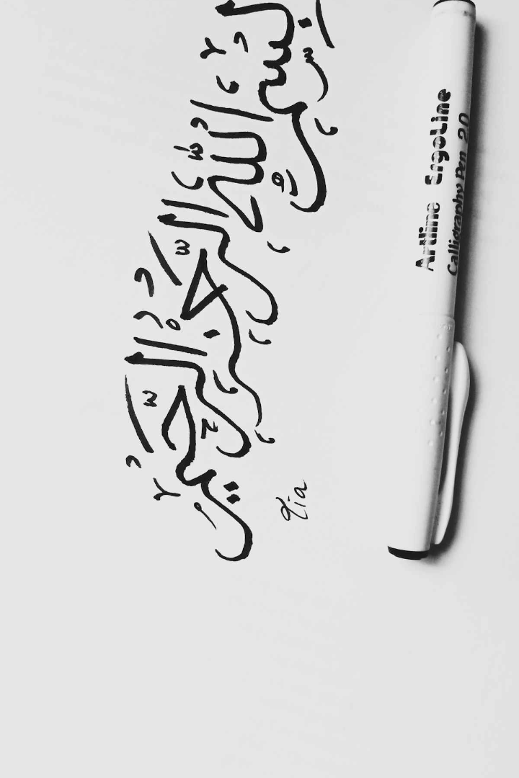
Arabic Text Generation: Deep Learning for Poetry Synthesis
This presentation explores the use of deep learning for Arabic poetry synthesis, a novel approach to preserving and enhancing this vital art form. We'll examine the unique challenges of generating Arabic text, the recent advances in natural language processing, and our proposed method using generative adversarial networks. Join us as we delve into the potential of AI to revitalize Arabic poetry.
Team:​
1-Marina Reda 221101235
2-Omar Adly 221101398​
3-Hazem Ahmed 221100343 ​
4-Ali sherif 221101562​
5-Loay Gamal 221100419

Slide 2
Technological Background:
Techniques:
Tools:
Challenges:
- LSTM for sequence prediction.
- Word2Vec for word embeddings.
- Python, Pandas, NumPy, Google Colab.
- High hardware and memory requirements.

Slide 3
Motivation: Preserving the Art of Arabic Poetry
Rich Cultural Heritage
Endangered Art Form
Preserving Legacy
Arabic poetry holds immense cultural significance, embodying the language's beauty and history.
The art of poetry is facing a decline, with fewer young people engaging with traditional forms.
Our research aims to utilize AI to revitalize Arabic poetry and inspire new generations.

Slide 4
Dataset Description , Key Findings and Insights:
58,000
7,000
Poems
Poems
Kaggle Arabic Poems , 6M words.
Alqasidah.com, 1M words.
70%
65%
50%
Fluency
Authenticity
Creativity
The model generated poems with high fluency and grammatical correctness.
Evaluators found the poems to be authentic and reflective of traditional styles.
The model demonstrated creativity, producing poems with novel metaphors and imagery.

Slide 5
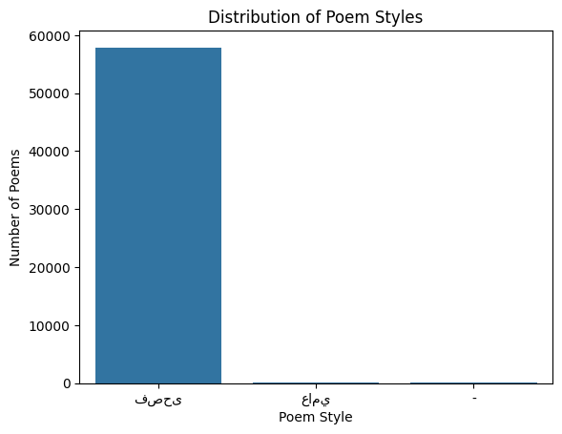
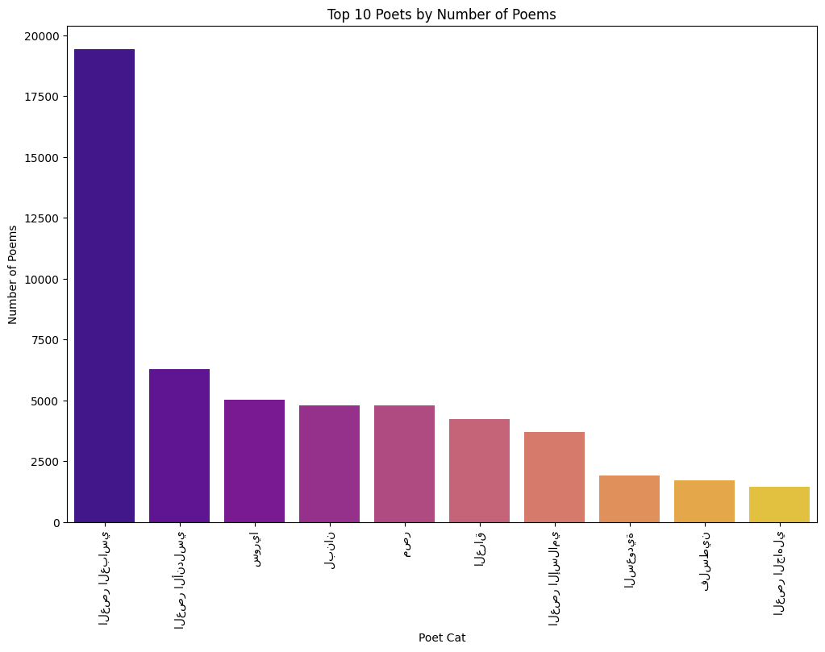
Dataset Description
Arabic poetry is one of the oldest and most important literary traditions in the world. It has a rich history that dates back over 1,500 years starting with pre-Islamic poetry and continuing to the modern day. Arabic poetry covers a wide range of themes, including love, nature, social issues, and philosophy. Over time, it has evolved in form and stylet.
The dataset used in this project contains over 58,000 Arabic poems spanning from the 6th century to the present day

Slide 6
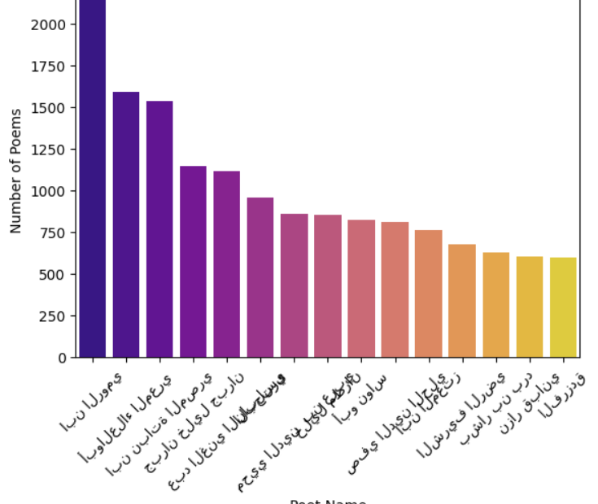
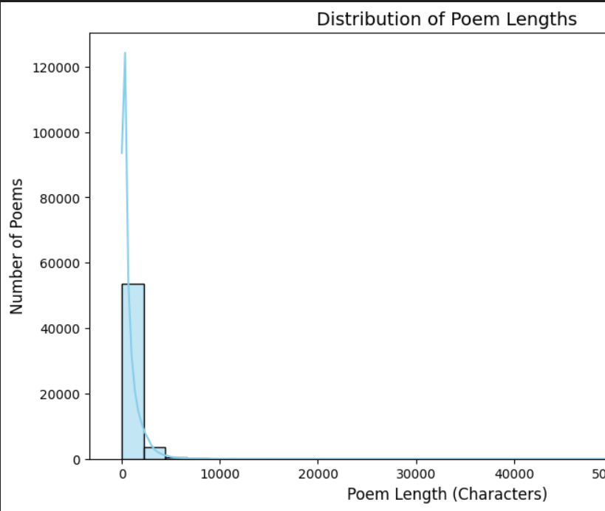
Dataset Description and sample of visualization

Slide 7



• Preprocessing:
- Removed diacritics, punctuation, and incorrect words.
- Handled numbers and non-vocabulary words.
-Tagging unknown words with `<UNK>`.

Slide 8
Limitations and Future Directions
Data Scarcity
The availability of annotated Arabic poetry data is limited.
Domain Specificity
The model is currently specialized in generating specific poetic forms.
Ethical Considerations
Addressing potential biases and misuse of AI for poetry generation.

Slide 9



Proposed Approach: Generative Adversarial Networks for Poetry Synthesis
Poetry Generator
1
A GAN model trained on a dataset of Arabic poems.
Discriminator
2
Evaluates generated poems for authenticity and quality.
Adversarial Training
3
Generator learns to fool the discriminator by producing realistic poems.

Slide 10

Methodology
1
Dataset
Dataset preprocessing and subsetting
Model Training
2
Developed bidirectional LSTM models
Used AraVec for word embedding
3
Evaluation
Human evaluation of poem quality, fluency, and adherence to traditional constraints.
4
test
- Tested different sequence lengths (1, 2, 5, 10).
- Tree-based path generation for sentences.

Slide 11
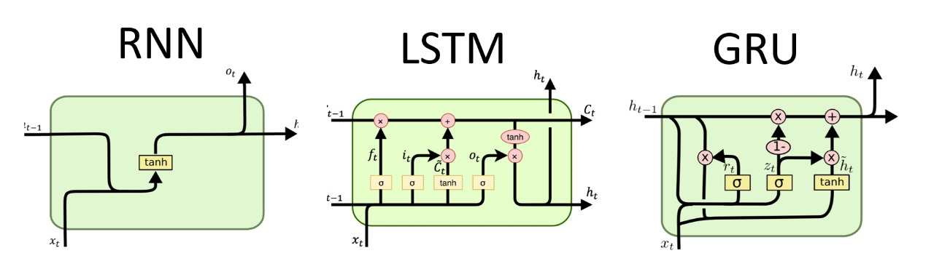
Enhancments:
1
Adjust Temperature:
- A lower temperature (e.g., 0.5) generates safer, more predictable text.
- A higher temperature (e.g., 1.0) introduces more creativity.
Use GridSearchCV for a more exhaustive search over a small set of hyperparameters
(e.g., for parameters that are critical for the model's performance).
Use RandomizedSearchCV for a wider and more random search over hyperparameters
(e.g., for parameters where the search space is large).
2
3
we could use a GRU (Gated Recurrent Unit) instead of the LSTM layer
The GRU is used instead of an LSTM.
GRUs are similar to LSTMs but use fewer parameters because they combine the forget and input gates into a single update gate. This makes GRUs faster to train and often perform similarly to LSTMs

Slide 12
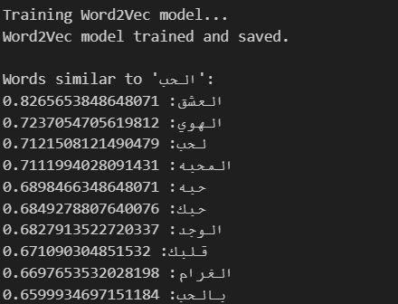
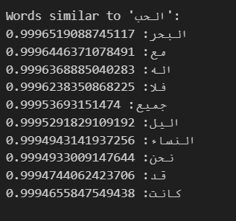
Enhancments:
When Increasing the data size to improve models by:
4
- Better Generalization: The model learns from more examples, making it better at handling unseen data.
- Improved Word Representations: With more data, the model gets better at understanding word meanings and relationships.
- BUT: all data requires an additional 2 weeks to run
- Challenges: It requires more computing power and may not always provide huge improvements after a certain point.
After Model Result:
Before Model Result:

Slide 13
• Related Work:
Paper | Scope & Poem Structure | Approach | Innovations | Evaluation
Ghazvininejad et al.([7,8]) | Shakespearean sonnet (14 lines, AABB CDCD EFEF GG rhythm, 10 stress patterns per line) | FSA for valid sequences, RNN for fluent paths, encoder-decoder seq2seq model | UI enhancements, adjustable parameters, forward and backward RNNs, vocabulary pruning, GPU utilization, rhythm precomputation | Human evaluation (23 participants); results were fluent but not creative
Loller et al.([10]) | Stanza of 4 lines (8 syllables, AABB rhythm) | LSTM for next-word prediction, tree-based grammar check, depth-first tree pruning | GAN for thematic coherence evaluation, CNN feature matrix, tree pruning for performance, embedded discriminator for novelty and thematic consistency | Compared to seq2seq, GAN, and CAVE methods; solved vocabulary repetition issue
Wang et al.([11]) | Chinese quatrains (4 lines, consistent syllable count: 5, 6, or 7) | Topic planning approach, TextRank for keyword extraction, RNN encoder-decoder with GRU | Subtopic planning for coherence, encyclopaedia-based keyword expansion, word embedding for a 6000-word vocabulary | Evaluated on poeticness, fluency, coherence, and meaning by human assessors
Yi et al. ([12]) | General poem text generation | Mutual reinforcement learning (two learners and a reward function for gradient updates) | GRU,Reward functions for fluency, coherence, and novelty; ANN combined with TF-IDF; intercommunication between learners for improved paths | Human evaluation; rewards classified generated poems as human, masterpiece, or system-authored

Slide 14
• Related Work:
Paper | Scope & Poem Structure | Approach | Innovations | Evaluation
Clark et al. ([16]) | Story and slogan generation | Machine in the Loop (MIL), turn-based generation for story writing | Wikiquote-based slogan help, human-machine collaboration for story generation | No specific evaluation details provided
Clark et al. ([13]) | Narrative text generation (short fiction or news stories) | Entity-based vector representations, sequence-to-sequence model | Entity state tracking for coherence, improved sentence generation based on entity states | Addressed issues like character reference accuracy
Soliman et al. ([14]) | Word embeddings for Arabic poetry | CBOW and Skip-gram models for word prediction | AraVec embedding model trained on diverse Arabic sources; mixed modern Arabic and dialects | Highlights role of strong word embeddings in improving fluency and diversity
Loller & Cheng et al. ([9,10]) | Keywords and visual input for poem generation | Word2Vec for topic expansion, CNN for image-based topical keywords | Image sentiment extraction for diverse topics, line generation based on previous lines, keyword-based flow improvements | Visual input led to coherent but topic-diverse poems; keywords had random flow issues

Slide 15




Experiment and Models:
LSTM
• Used bidirectional LSTM for forward and backward training.
• Explored the effect of sequence length on
Quality:
- Shorter sequences: More meaningful results.
- Longer sequences: Repetitive and less coherent.
Evaluation
• Sentence probabilities calculated using log probabilities.
• Human evaluators assessed:
- Coherence, fluency, and poeticness.
• Model-2 (two-word sequence) achieved the best results.

Slide 16

Advances in Deep Learning for Natural Language Processing
Recurrent Neural Networks (RNNs)
RNNs are particularly effective for processing sequential data, such as text.
Generative Adversarial Networks (GANs)
GANs are a powerful framework for generating realistic and creative outputs.
Transformer Networks
Transformer networks excel at capturing long-range dependencies in language.

Slide 17
Background: The Unique Challenges of Arabic Text Generation
Complex Script
Rich Semantic Nuance
Arabic script's right-to-left direction and diacritical marks pose challenges for text processing.
Arabic poetry is characterized by intricate rhyme schemes and poetic devices.
Limited Training Data
The availability of annotated Arabic poetry datasets is limited, hindering model training.

Slide 18
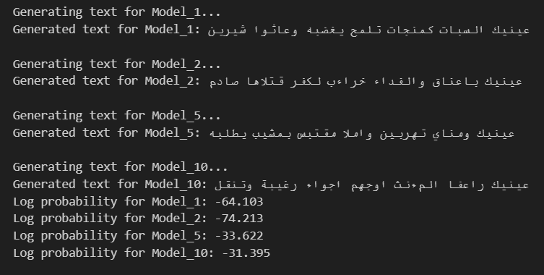
Results:
• Generated poetry examples:
- Shorter sequences produced more coherent lines.
- Longer sequences favored frequent words.
• Evaluation:
- Model-2 outperformed others in coherence.

Slide 19

Conclusion:
Our research demonstrates the potential of deep learning to preserve and revitalize Arabic poetry. We invite further research to address the limitations and expand the model's capabilities. Together, we can leverage AI to safeguard this valuable cultural heritage and inspire future generations of poets.

